Slide 1

e- Commerce Customer Retention
Ramesh pyru
Internship 34

Slide 2
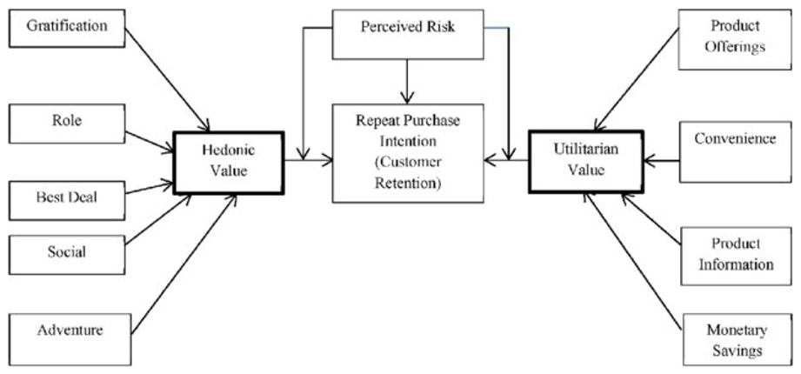
Agenda
Introduction
problem statement
EDA Approach &steps
Visualization
Analysis
conclusion

Slide 3

Introduction
Currently many e-Commerce websites are available to customer’s having tough competition for the continuous business growth & revenues where customer activation & retention is critical
Customer Satisfaction is identified as Key factor for repeat purchases & retention of customers .We need to further analyze the data collected from Indian e-commerce customers on how both utilitarian value and hedonistic values affects customer purchase intention
Other success factors →service quality, system quality,information quality, trust and net benefit.
.

Slide 4

Problem statement
Need for e-retail success factors which influence customer Satisfaction .Both Hedonic & Utilitarian values affect the customer repeat purchase retention & need to focus on the combination considering the perceived risks
Data Collection &Cleaning
Univariate Analysis
Bivariate Analysis
Multivariate Analysis
EDA
Visualization
Analysis
Sample Data
Missing Values imputation
Handling Outliers
Analyze for one Variable
Histograms
Count Plots
Stem and Leaf Plots
Analyze for two Variables
Bar plot
Cross Tab
Scatter Plot
Analyze for > 2 Variables
Line plot
Heat Map
Pair Plot
Correlation between Categorical variables
Correlation for Hedonic & Utilitarian values
Analysis
Conclusion

Slide 5

EDA Approach &Outcome
Known factor →Customer Satisfaction
5 more ➔service quality, system quality, information quality, trust and net benefit
Hedonic Value--->
is defined as value a customer receives based on the experience of products which are associated with fun, pleasure, and excitement, examples---> perfumes, flowers, luxury watches
--Psychological/Emotional experience
1.Gratification
2.Role
3.Best Deal
4.Social
5.Adventure
Utilitarian Value--->
is defined as value that a customer receives based on a task-related and rational consumption behavior,examples-->personal computers, detergents..
--Practical/Real
1.Product Offerings
2.Convenience
3.product Information
4.Monetary Savings
Outcome→
Factors for Customer repeat purchase intention (loyalty)
Factors for customer retention

Slide 6
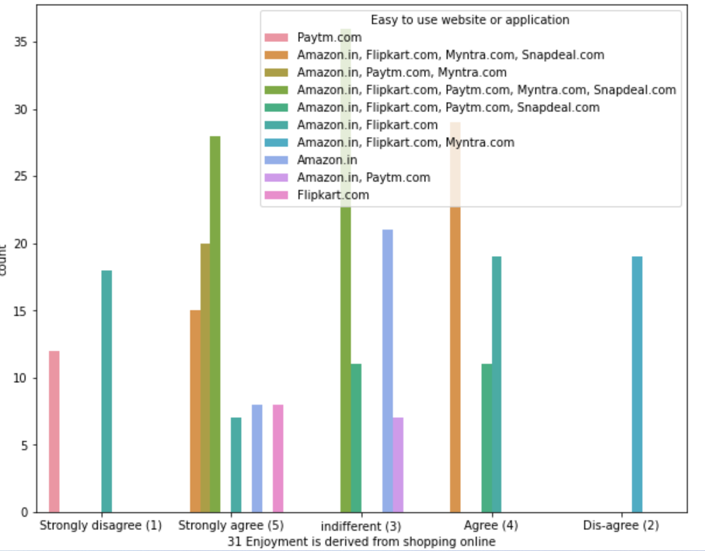
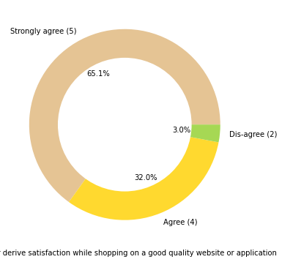
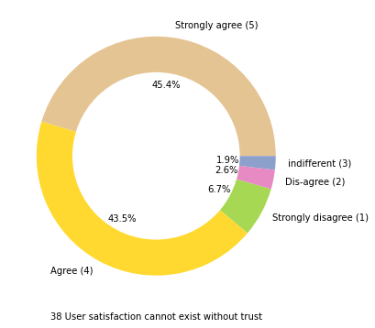
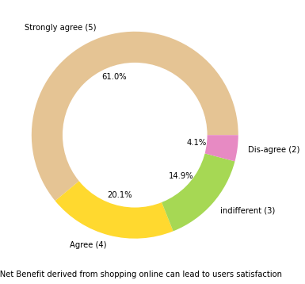
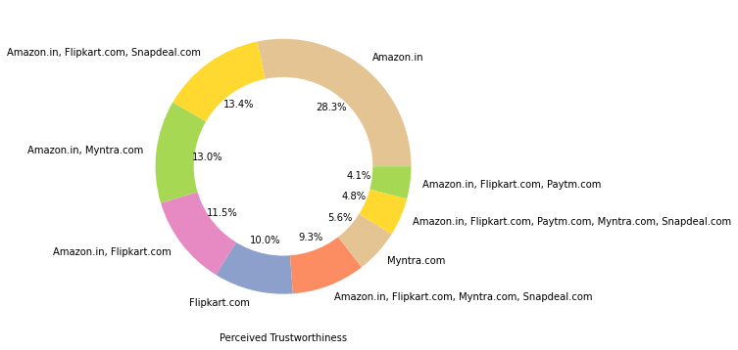
Hedonic Value(HV) Analysis

Slide 7
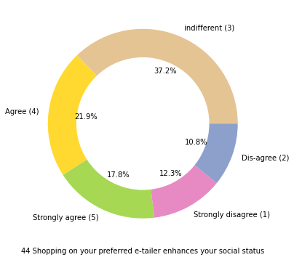
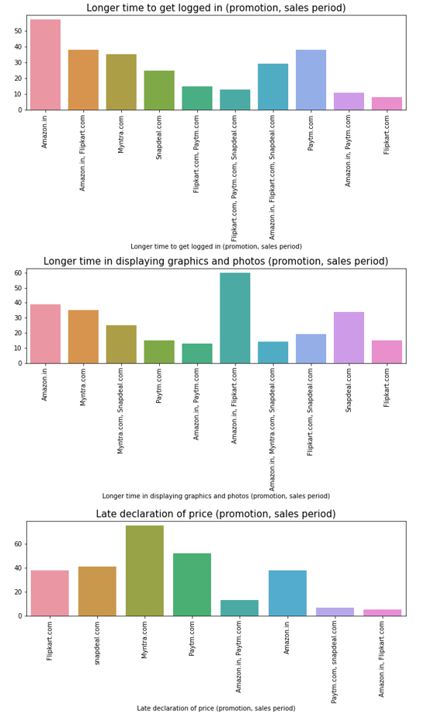
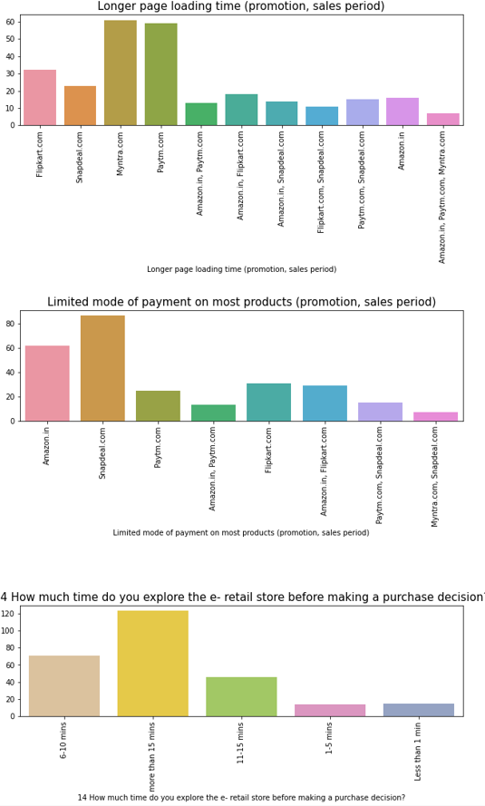
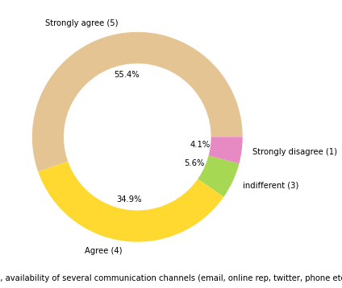
Hedonic Value(HV) Analysis

Slide 8
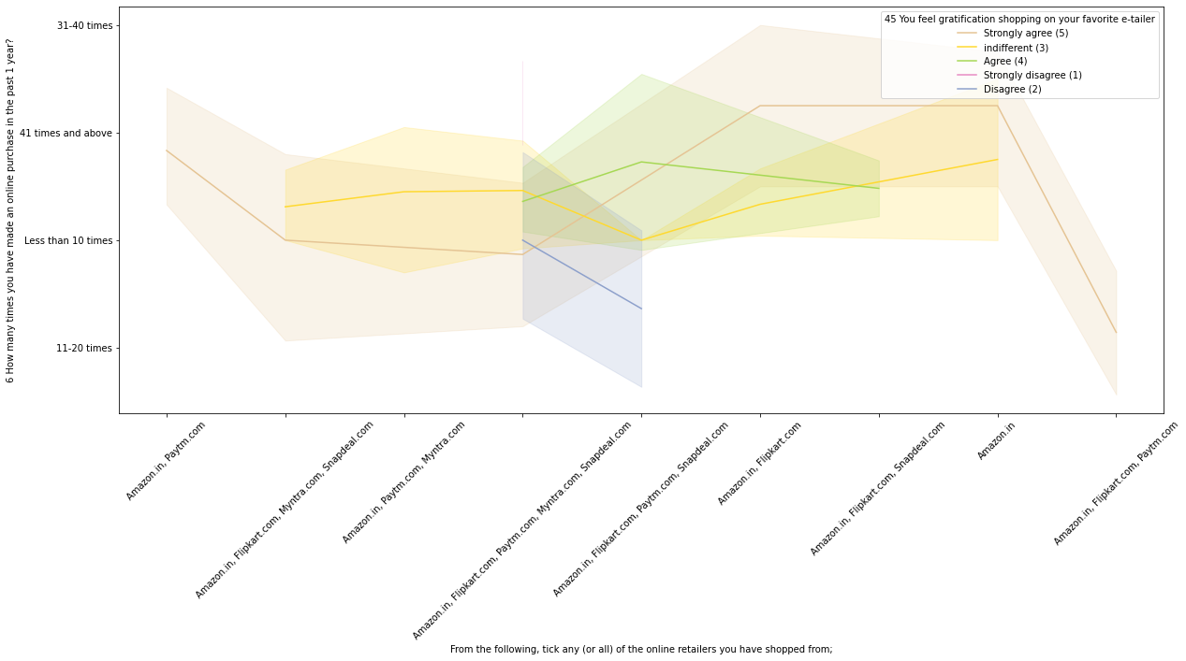
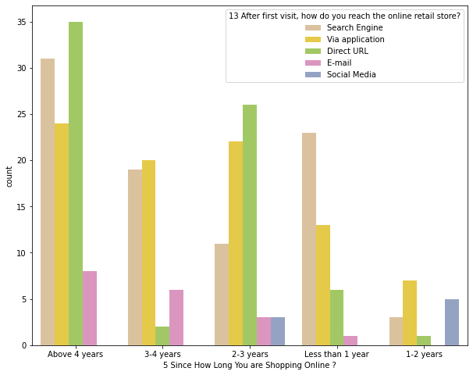
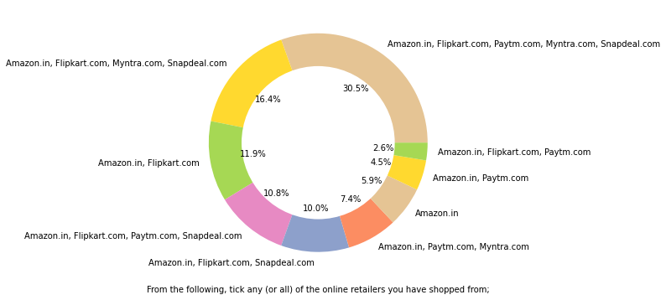
Hedonic Value(HV) Analysis

Slide 9

“Hedonic Value(HV)” Observations
Pie plot also show that being able to guarantee the privacy of the customer is important silent feature for product selection. Another most important for product companies is availability of communication channels.
32% customer enjoyment from online shopping strongly matter
85 % of customer thinks, online shopping is convenient & flexible than physical shopping.
45.4% of customers strongly agree over fact that user satisfaction cannot exist without trust.
42.8 % customer strongly agree and 41.6 % customer agree over high loading & processing speed.
Longer time to get logged in can annoyed customer. Amazon.in take longer time to logged in
Most of the Customers spend more than 15 mins before making Purchase decision. Followed by 6-10 mins before making purchase decision.
More people strongly agree to derive Enjoyment from shopping online based on the easiness of the application from Amazon,flipkart,paytm,SnapDeal,Myntra
We can see different peoples have different opinions about connection between e-tailer & social status. Same with gratification on favorite e-tailer.
Customers seem to be more loyal to amazon, flipkart and paytm as even though many of them have given negative remarks about them still they would recommend these platforms to their friend
Feature_Gratifiction
Feature_BestDeal
Feature_social
Feature_adventure

Slide 10
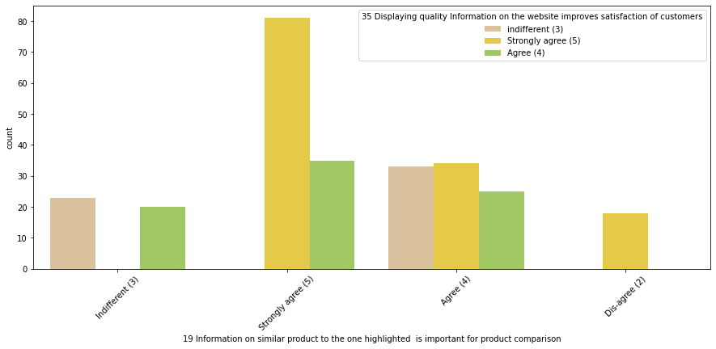
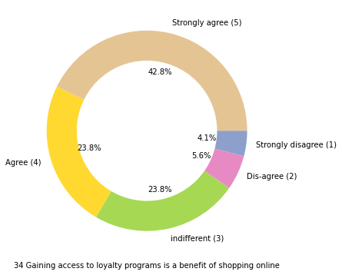
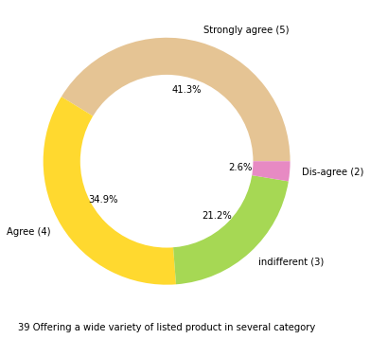
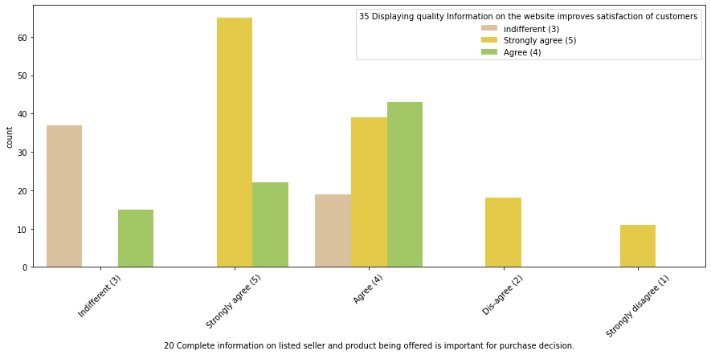
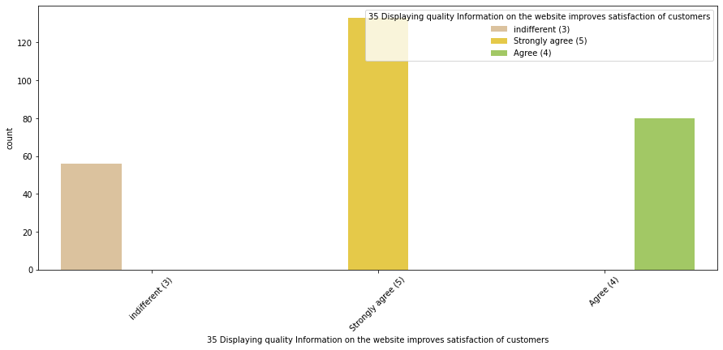
Utilitarian Value(UV) Analysis

Slide 11
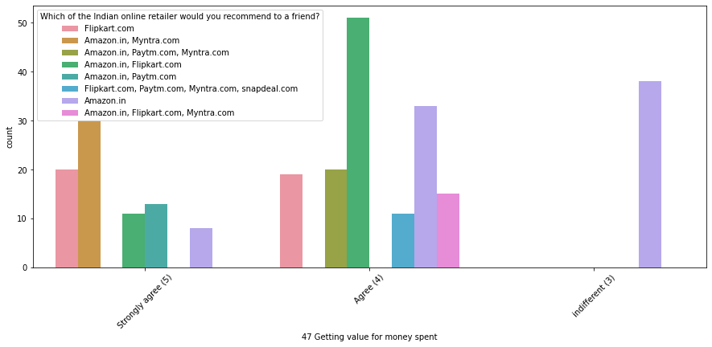
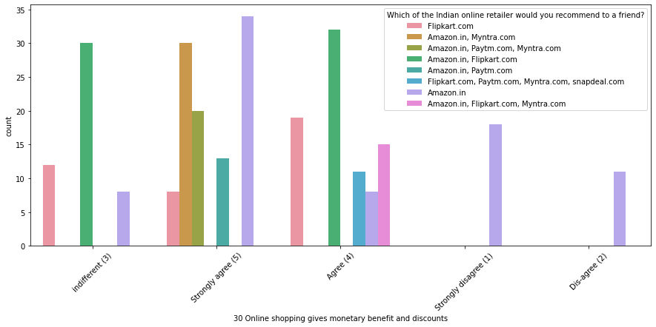
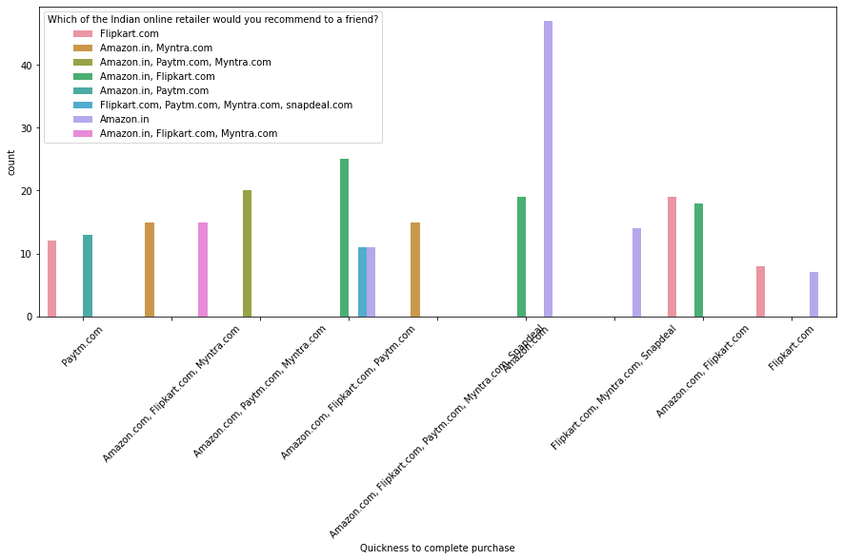
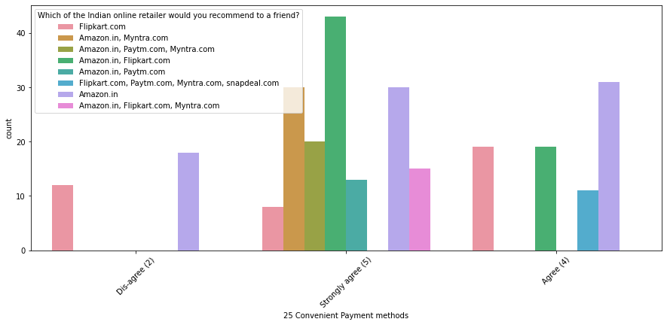
Utilitarian Value(UV) Analysis

Slide 12
“Utilitarian Value(UV)” Observations
More customers look for Product offers while shopping online
More than 60% of customer agree or strongly agree that complete information on listed seller and product being offered is important for purchase decision.
Most of the Customers strongly agree thinks that companies readiness to assist customer queries related to product is important factor in purchase decision.
Large portion of customers strongly agree that content on website must be easy to read and understand.
Customer strongly agree that information on similar product to highlighted on website for product comparison.
More than 90% of customer agree or strongly agree that all relevant information on listed products must be stated clearly.
Majority of people also think that Amazon.in tops the chart in terms of quickness purchase process compare to others.
Safe & Speed delivery very much deciding factor in terms of purchase.
Most of the customer thinks that return & replacement policy of e-seller is important factor for making purchase decision.
Around 83% customer pursue online shopping for Monetary Savings.
55.4% people strongly agree and 30.5% people agree that they prefer online shopping because they get value of money spent.
Feature_productOffer
Feature_productInfo
Feature_convenience
Feature_Savings

Slide 13
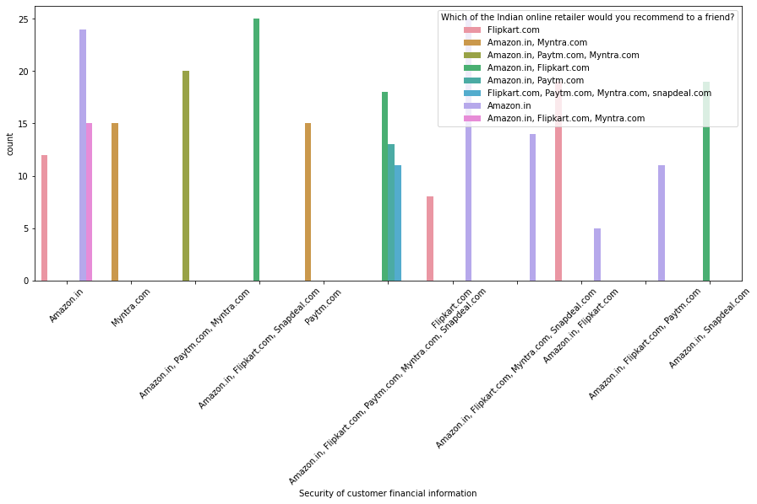
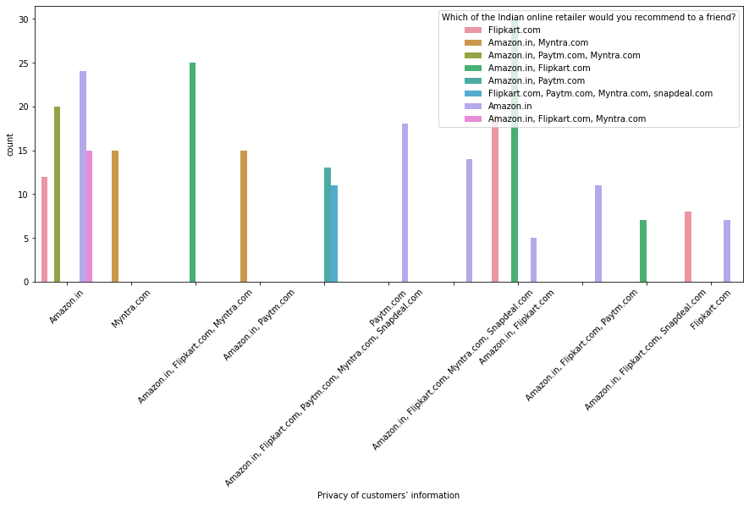
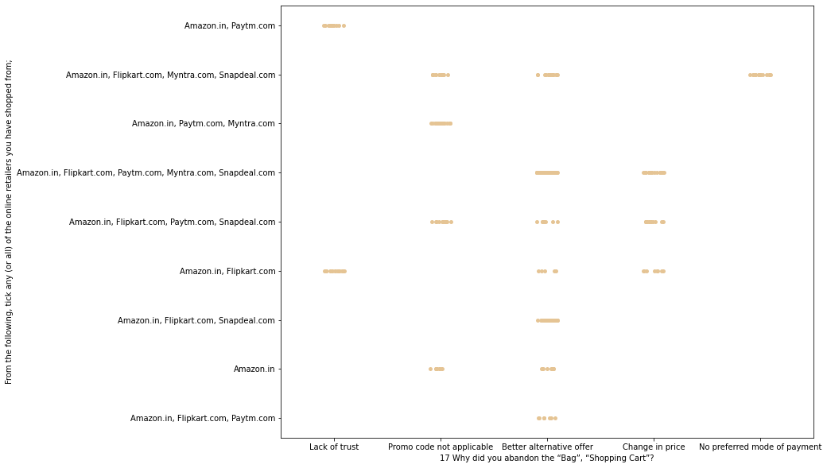
Perceived Risks Analysis

Slide 14
“Perceived risks(UV)” Observations
Customers seem to be more loyal to amazon, flipkart and paytm as even though many of them have given negative remarks about them still they would recommend these platforms to their friend
Majority of customer trust Amazon.in followed by Flipkart.in over Security of their financial information.
Another most common reason to abandon purchase decision is promo code not applicable on particular product. Followed by next most common reason is change in price.
we can conclude that 84% customer abandon cart due to cost & discount tradeoff
Feature_risk

Slide 15
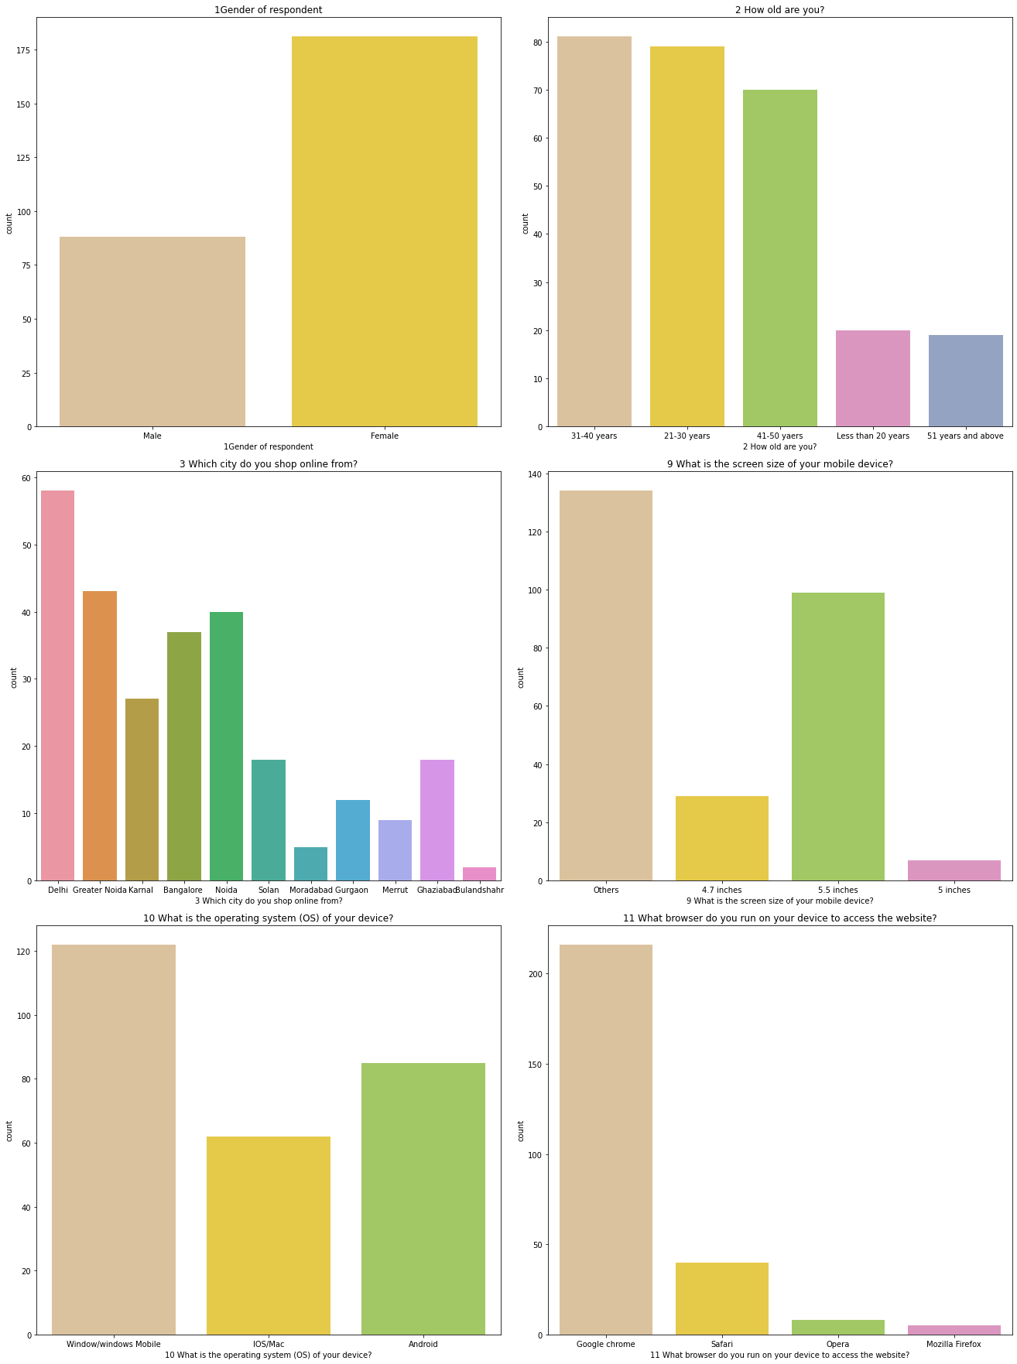
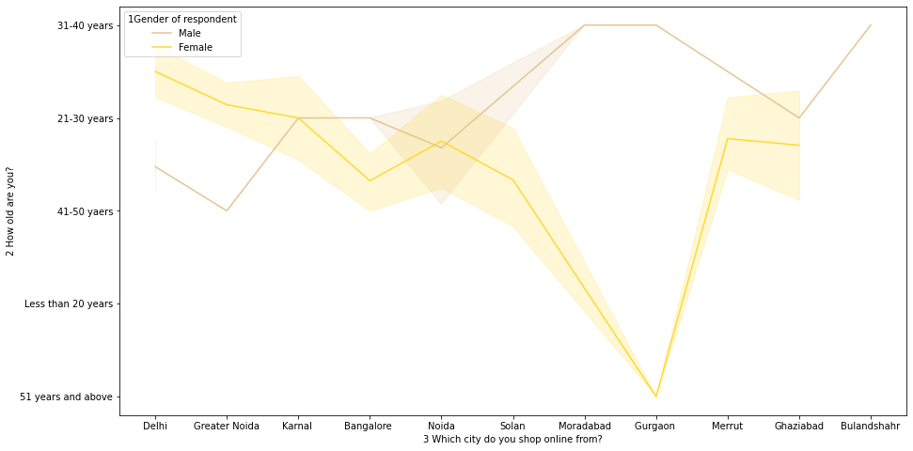
Customer Analysis

Slide 16
“customer” Observations
Most Online Shopping Customer belong to Metro Cities. and most of them are FeMale customer
We can conclude that in Metro city like Delhi, Male have more tendency of online shopping. So shopping platform can target this population in marketing.
In Tier 2 & 3 Cities Majority of online shopping customers are Females.
We can target these customer population in these cities.
Highest number of people have been shopping online for above 4 years except for the age group below 20 years and above 50 years.
People who are shopping online for 1-2 years does not include teenagers and elder people.
Feature_Customer

Slide 17
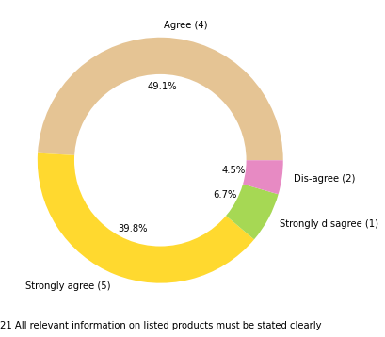
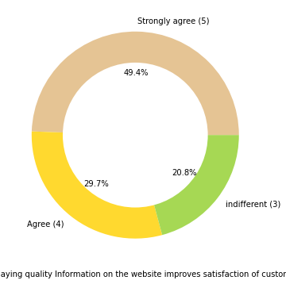
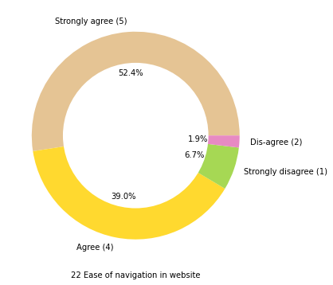
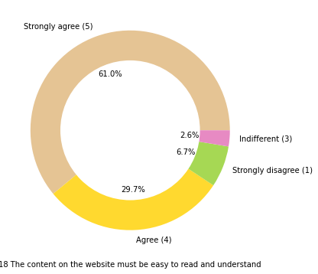
Other factor Analysis service quality, system quality, information quality, trust and net benefit.

Slide 18
“Other Factors”Observations service quality, system quality, information quality, trust and net benefit.
Most of people want shorter delivery time frame, majority customer agree that Paytm.com takes longest time for delivery compare to others.
50.2% Customer strongly agree & 36.4% customer agree that for good online shopping complete and relevant product information.
49.4% customer strongly agree and 29.7% customer agree that displaying quality information on website helps in decision making in turn improves customer satisfaction.
70.3 % customer strongly agree and 16.7 % customer agree that website should be user friendly.
52.4% of customers strongly agree that website should be easy for navigation..
Feature_majorfactors

Slide 19
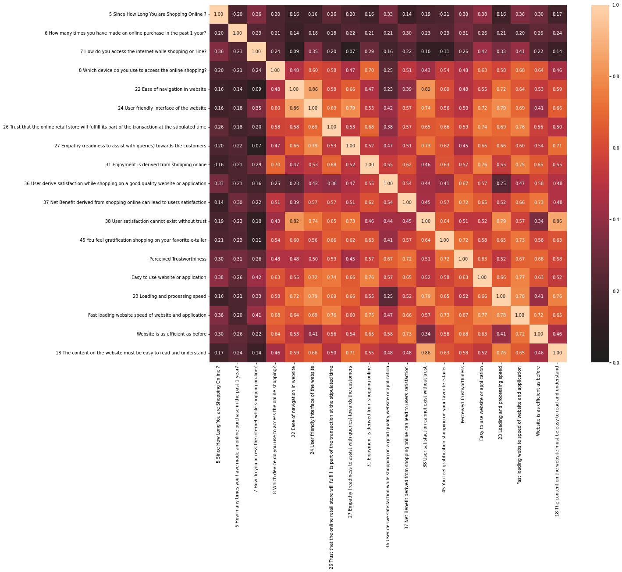
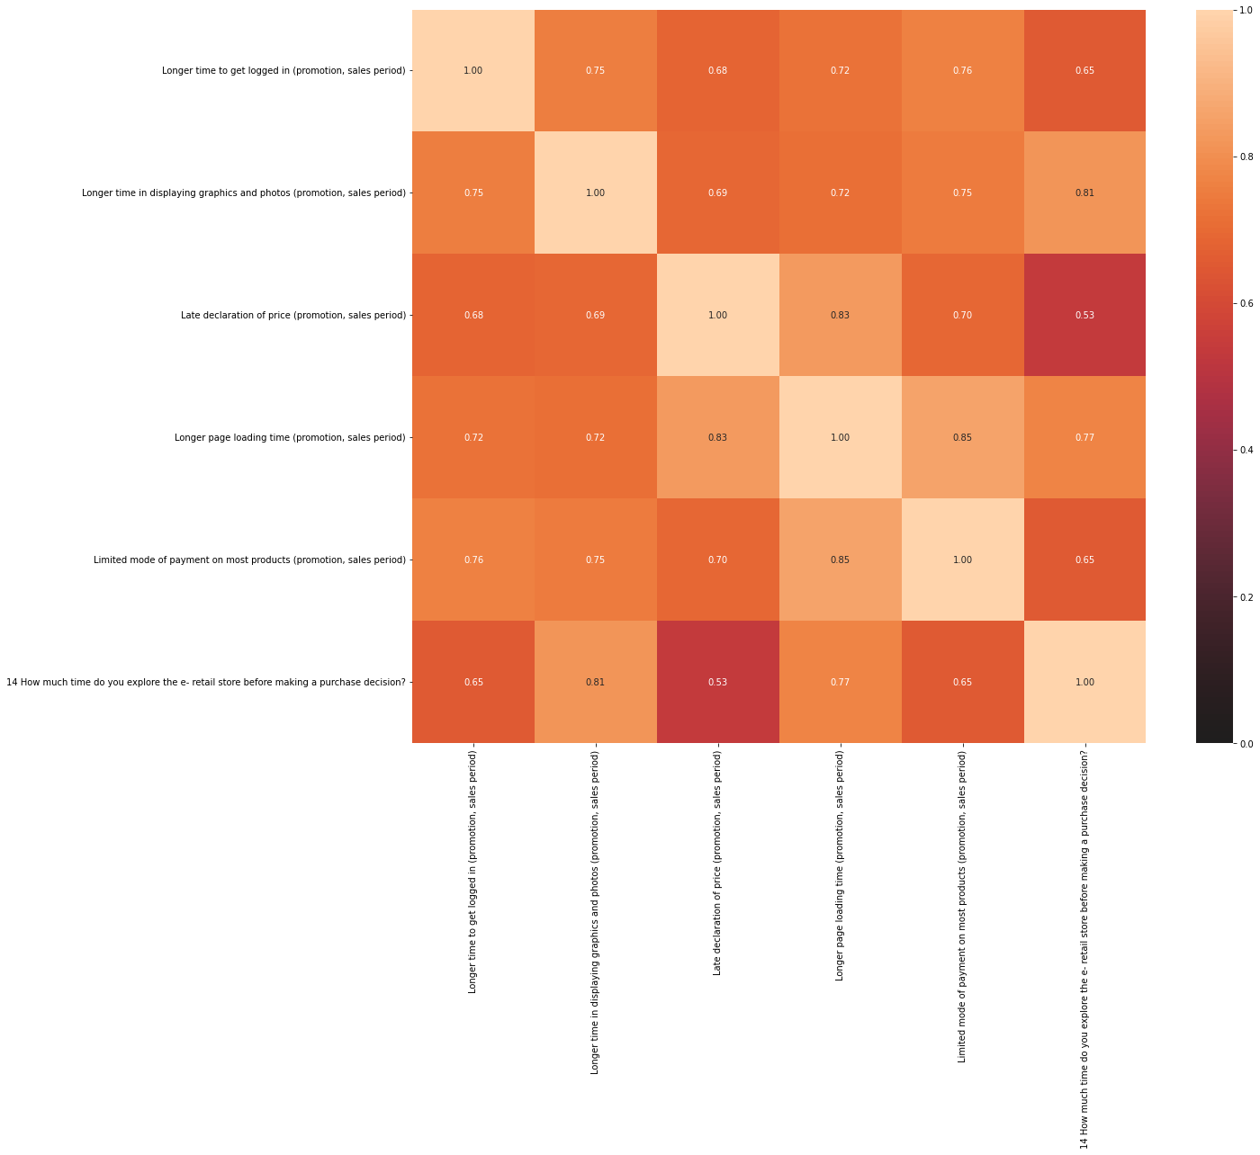
Correlation with HV

Slide 20
“HV Correlation” Observations
Below are highly correlated based on the scores ~1
18 The content on the website must be easy to read and understand-->(0.86)-->38 User satisfaction cannot exist without trust
22 Ease of navigation in website--(0.82) --> 38 User satisfaction cannot exist without trust
23 Loading and processing speed->(0.79)-->24 User friendly Interface of the website
27 Empathy (readiness to assist with queries) towards the customers---(0.79) -->24 User friendly Interface of the website
Limited mode of payment on most products (promotion, sales period)--->(0.85)-->Longer page loading time (promotion, sales period)
Presence of online assistance through multi-channel-->(0.83)-->Which of the Indian online retailer would you recommend to a friend?
14 How much time do you explore the e- retail store before making a purchase decision?--->(0.77)-->Longer page loading time (promotion, sales period)
An effect score closer to 0 translates to there being no relationship.
A score closer to 1 or -1 is a positive or negative relationship
A perfect score of 1 is a direct correlation

Slide 21
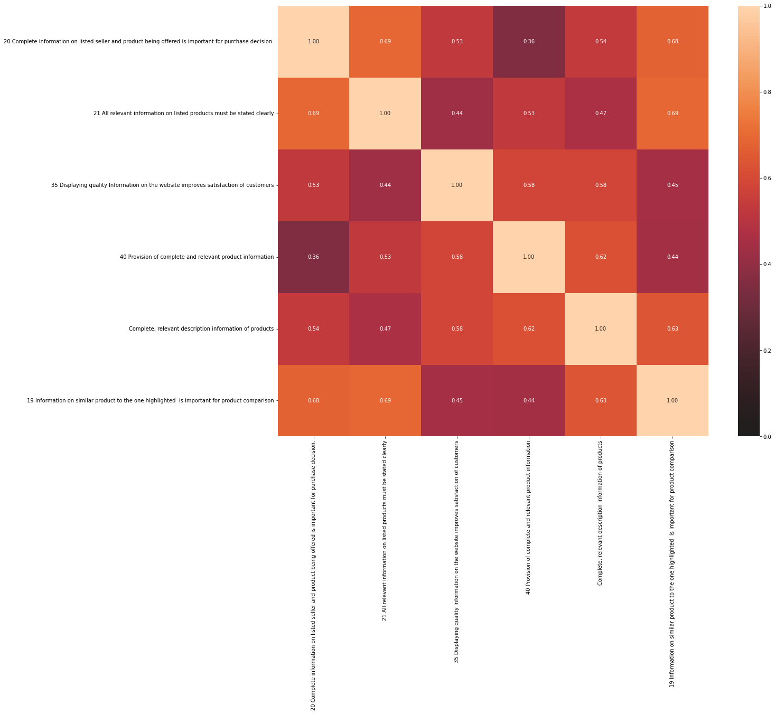
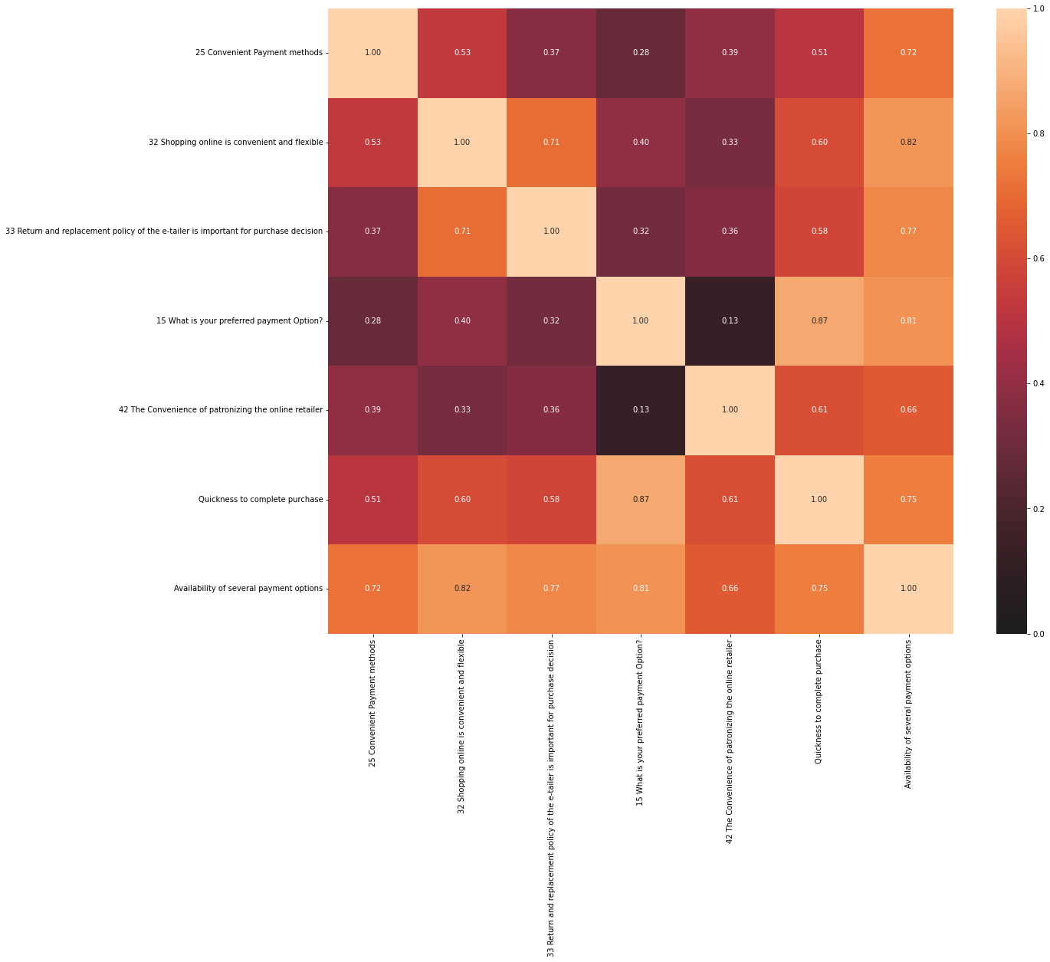
Correlation with UV

Slide 22
“UV Correlation” Observations
Quickness to complete purchase -->( 0.87 )-->15 What is your preferred payment Option?
32 Shopping online is convenient and flexible-->(0.82)-->Availability of several payment options
Availability of several payment options -->( 0.81 )-->15 What is your preferred payment Option?.
An effect score closer to 0 translates to there being no relationship.
A score closer to 1 or -1 is a positive or negative relationship
A perfect score of 1 is a direct correlation

Slide 23
Correlation with HV & UV Based on chi-square test ( P-value)
Feature_productOffer = ['34 Gaining access to loyalty programs is a benefit of shopping online',
'Wild variety of product on offer',
'39 Offering a wide variety of listed product in several category']
Feature_Gratifiction= ['5 Since How Long You are Shopping Online ?',
'6 How many times you have made an online purchase in the past 1 year?',
'7 How do you access the internet while shopping on-line?',
'8 Which device do you use to access the online shopping?',
'22 Ease of navigation in website',
'24 User friendly Interface of the website',
'26 Trust that the online retail store will fulfill its part of the transaction at the stipulated time',
'27 Empathy (readiness to assist with queries) towards the customers',
'31 Enjoyment is derived from shopping online',
'36 User derive satisfaction while shopping on a good quality website or application',
'37 Net Benefit derived from shopping online can lead to users satisfaction',
'38 User satisfaction cannot exist without trust',
'45 You feel gratification shopping on your favorite e-tailer',
'Perceived Trustworthiness',
'Easy to use website or application',
'23 Loading and processing speed',
'Fast loading website speed of website and application',
'Website is as efficient as before',
'18 The content on the website must be easy to read and understand']
Feature_Savings = ['30 Online shopping gives monetary benefit and discounts',
'41 Monetary savings',
'47 Getting value for money spent’]
Feature_social = ['12 Which channel did you follow to arrive at your favorite online store for the first time?',
'29 Responsiveness, availability of several communication channels (email, online rep, twitter, phone etc.)',
'44 Shopping on your preferred e-tailer enhances your social status',
'Presence of online assistance through multi-channel',
'From the following, tick any (or all) of the online retailers you have shopped from;',
'Which of the Indian online retailer would you recommend to a friend?']

Slide 24
“HV & UV COrrelation”Observations
Feature_Savings (UV) && Feature_social(HV) are highly correlated based on p-Value of chi-Square test
Feature_productOffer(UV) && Feature_Gratifiction(HV) are highly correlated based on p-Value of chi-Square test
An effect score closer to 0 translates to there being no relationship.
A score closer to 1 or -1 is a positive or negative relationship
A perfect score of 1 is a direct correlation

Slide 25
Analysis
HV & UV
Intention of Repeat purchase
UV Based Intention of purchase
HV Based Intention of purchase
General observation
Model
Heavy shoppers who shop more than 41 times a year shop from all the online brands,
some of the people who shop for 32-40 and less than 10 times a year seem to exclude Myntra.
People shop from Amazon and flipkart
People shopping from amazon and paytm are getting benefits from the loyalty points
flipkart and Snapdeal also seem to give such benefits but people who shop from almost everywhere disagree with this statement
Almost all the people who have shopped from amazon, flipkart and paytm are satisfied
People who shop from a more number of online brands doesn't seem to be satisfied.
online brands should update all their platforms rather than just application
Further analysis with Model building can give more insights

Slide 26

Conclusion
Customer retention (UV+HV)
Customer Retention (reduce risks)
People shopping from amazon and paytm are getting benefits from the loyalty points
People who shop from a more number of online brands doesn't seem to be satisfied.
Loyal customers prefer buying and tend to spend more money on shopping in your store. Statistics show that engaged consumers purchase more frequently
People shop from Amazon and flipkart whatever be the case.
Online brands should update all their platforms rather than just application

Slide 27


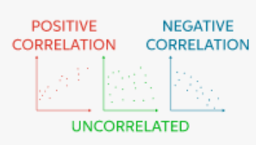

How we got there
EDA
Data divided with PV, UV & risks
Features with PV performed Visualizations
Featured with UV performed with Visualizations
Correlation
Used Dython library for correlation of Categorical Features Chi-Square test (Nominal Values)with P-Value
Analysis
Count plot, Pie Chart ,Line plots provided insights Combination of PV & UV features are derived

Slide 28
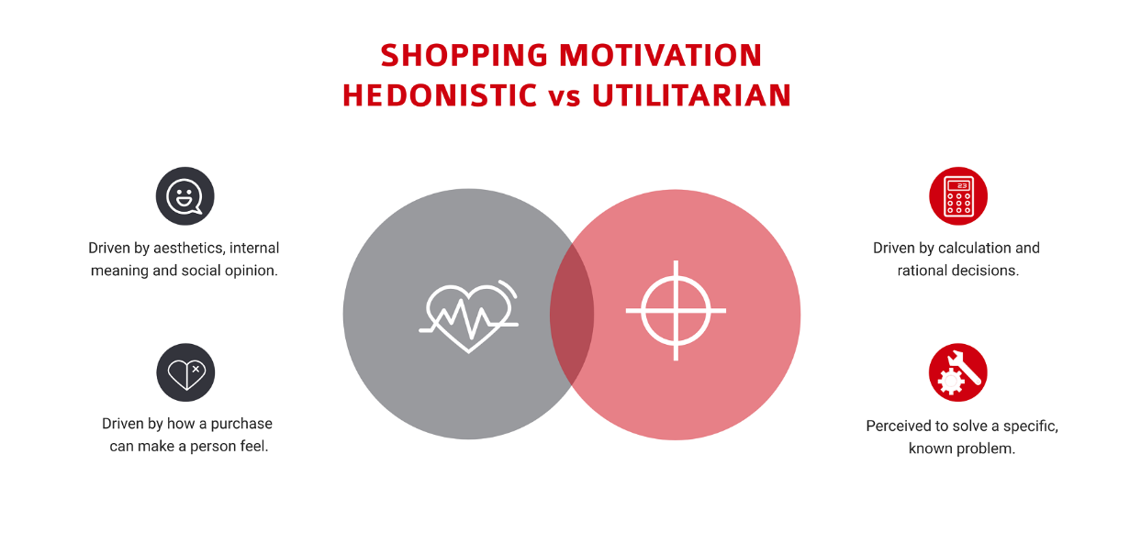

conclusion

Slide 29


Thank you
Ramesh Pyru​
Internship 34

